Slide 1
Chapter 6: CPU Scheduling

Slide 2
Chapter 6: CPU Scheduling
Basic Concepts
Scheduling Criteria
Scheduling Algorithms
Thread Scheduling
Multiple-Processor Scheduling
Real-Time CPU Scheduling
Operating Systems Examples
Algorithm Evaluation

Slide 3
Objectives
To introduce CPU scheduling, which is the basis for multiprogrammed operating systems
To describe various CPU-scheduling algorithms
To discuss evaluation criteria for selecting a CPU-scheduling algorithm for a particular system
To examine the scheduling algorithms of several operating systems

Slide 4

Basic Concepts
Maximum CPU utilization obtained with multiprogramming
CPU–I/O Burst Cycle – Process execution consists of a cycle of CPU execution and I/O wait
CPU burst followed by I/O burst
CPU burst distribution is of main concern

Slide 5

Histogram of CPU-burst Times

Slide 6
CPU Scheduler
Short-term scheduler selects from among the processes in ready queue, and allocates the CPU to one of them
  Queue may be ordered in various ways
CPU scheduling decisions may take place when a process:
  1. Switches from running to waiting state
  2. Switches from running to ready state
  3. Switches from waiting to ready
  Terminates
Scheduling under 1 and 4 is nonpreemptive
All other scheduling is preemptive
Notes:
Under nonpreemptive scheduling, once the CPU has been allocated to a process, the process keeps the CPU until it releases the CPU either by terminating or by switching to the waiting state

Slide 7
Dispatcher
Dispatcher module gives control of the CPU to the process selected by the short-term scheduler; this involves:
  switching context
  switching to user mode
  jumping to the proper location in the user program to restart that program
Dispatch latency – time it takes for the dispatcher to stop one process and start another running

Slide 8
Scheduling Criteria
CPU utilization – keep the CPU as busy as possible
Throughput – # of processes that complete their execution per time unit
Turnaround time – amount of time to execute a particular process
Waiting time – amount of time a process has been waiting in the ready queue
Response time – amount of time it takes from when a request was submitted until the first response is produced, not output (for time-sharing environment)
Notes:
Turnaround time is the sum of the periods spent waiting to get into memory, waiting in the ready queue, executing on the CPU, and doing I/O.

Slide 9
Scheduling Algorithm Optimization Criteria
Max CPU utilization
Max throughput
Min turnaround time
Min waiting time
Min response time

Slide 10

First- Come, First-Served (FCFS) Scheduling
Process Burst Time
P₁ 24
P₂ 3
P₃ 3
Suppose that the processes arrive in the order: P₁ , P₂ , P₃
The Gantt Chart for the schedule is:
Waiting time for P₁ = 0; P₂ = 24; P₃ = 27
Average waiting time: (0 + 24 + 27)/3 = 17

Slide 11

FCFS Scheduling (Cont.)
Suppose that the processes arrive in the order:
P₂ , P₃ , P₁
The Gantt chart for the schedule is:
Waiting time for P₁ = 6; P₂ = 0; P₃ = 3
Average waiting time: (6 + 0 + 3)/3 = 3
Much better than previous case
Convoy effect - short process behind long process
  Consider one CPU-bound and many I/O-bound processes

Slide 12
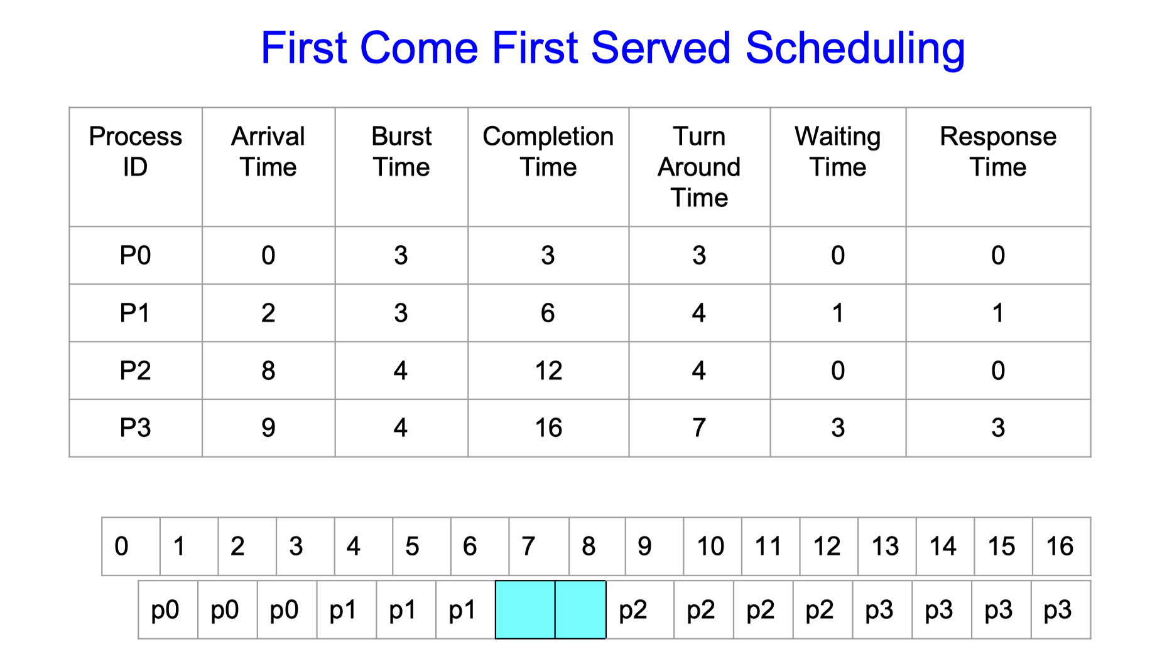
FCFS Scheduling (Cont.)
Notes:
Turnaround time: Completion time - Arrival time
Waiting Time: Turnaround time - Burst time
Response Time: Time to CPU Allocation - Arrival Time

Slide 13
Shortest-Job-First (SJF) Scheduling
Associate with each process the length of its next CPU burst
  Use these lengths to schedule the process with the shortest time
SJF is optimal – gives minimum average waiting time for a given set of processes
  The difficulty is knowing the length of the next CPU request
  Could ask the user

Slide 14

Example of SJF
ProcessArriva l Time Burst Time
P₁ 0.0 6
P₂ 2.0 8
P₃ 4.0 7
P₄ 5.0 3
SJF scheduling chart
Average waiting time = (3 + 16 + 9 + 0) / 4 = 7

Slide 15
Example of SJF
ProcessArriva l Time Burst Time
P₁ 0.0 6
P₂ 2.0 8
P₃ 4.0 7
P₄ 5.0 3
SJF scheduling chart
Average waiting time = (3 + 16 + 9 + 0) / 4 = 7

Slide 16
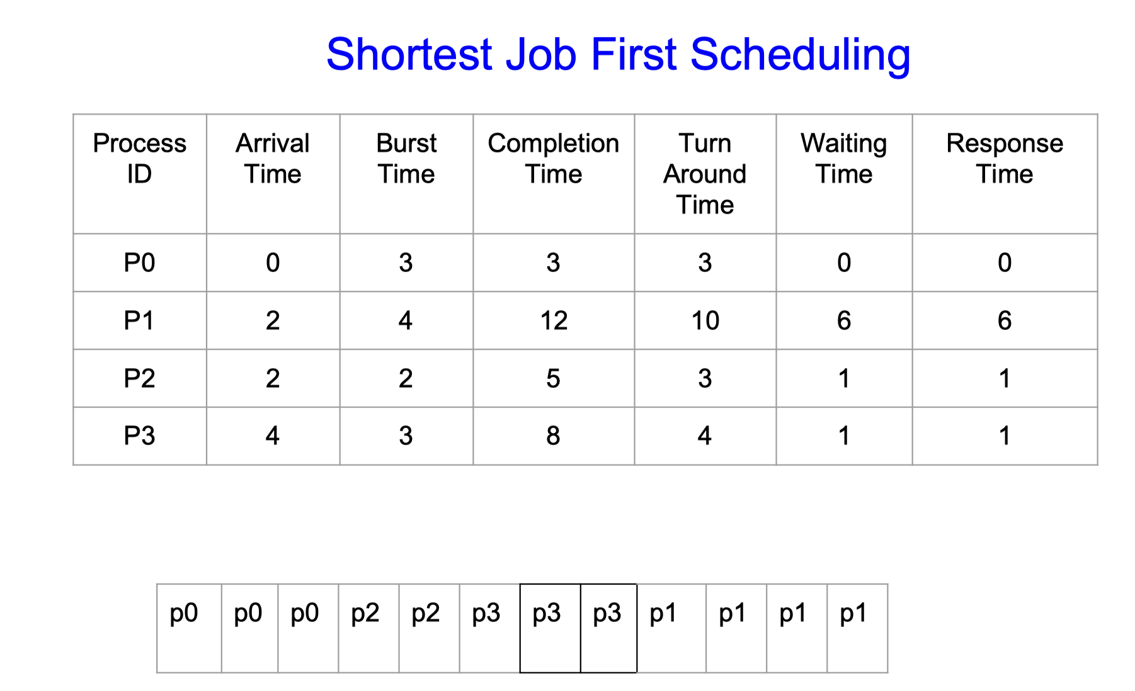
Example of SJF

Slide 17


Determining Length of Next CPU Burst
Can only estimate the length – should be similar to the previous one
  Then pick process with shortest predicted next CPU burst
Can be done by using the length of previous CPU bursts, using exponential averaging
Commonly, α set to ½
Preemptive version called shortest-remaining-time-first

Slide 18

Prediction of the Length of the Next CPU Burst

Slide 19
Examples of Exponential Averaging
α =0
  τ_{n+1} = τ_{n}
  Recent history does not count
α =1
  τ_{n+1} = α t_{n}
  Only the actual last CPU burst counts
If we expand the formula, we get:
    τ_{n+1} = α t_{n}+(1 - α)α t_{n} ₋₁ + …
    +(1 - α )^{j} α t_{n} _{-j} + …
    +(1 - α )^{n +1} τ₀
Since both α and (1 - α) are less than or equal to 1, each successive term has less weight than its predecessor

Slide 20

Example of Shortest-remaining-time-first
Now we add the concepts of varying arrival times and preemption to the analysis
ProcessA arri Arrival TimeT Burst Time
P₁ 0 8
P₂ 1 4
P₃ 2 9
P₄ 3 5
Preemptive SJF Gantt Chart
Average waiting time = [(10-1)+(1-1)+(17-2)+5-3)]/4 = 26/4 = 6.5 msec
Notes:
Aka of Preemptive SJF

Slide 21
Priority Scheduling
A priority number (integer) is associated with each process
The CPU is allocated to the process with the highest priority (smallest integer ≡ highest priority)
  Preemptive
  Nonpreemptive
SJF is priority scheduling where priority is the inverse of predicted next CPU burst time
Problem ≡ Starvation – low priority processes may never execute
Solution ≡ Aging – as time progresses increase the priority of the process

Slide 22

Example of Priority Scheduling
ProcessA arri Burst TimeT Priority
P₁ 10 3
P₂ 1 1
P₃ 2 4
P₄ 1 5
P₅ 5 2
Priority scheduling Gantt Chart
Average waiting time = 8.2 msec

Slide 23
Round Robin (RR)
Each process gets a small unit of CPU time (time quantum q), usually 10-100 milliseconds. After this time has elapsed, the process is preempted and added to the end of the ready queue.
If there are n processes in the ready queue and the time quantum is q, then each process gets 1/n of the CPU time in chunks of at most q time units at once. No process waits more than (n-1)q time units.
Timer interrupts every quantum to schedule next process
Performance
  q large ⇒ FIFO
  q small ⇒ q must be large with respect to context switch, otherwise overhead is too high
Notes:
FCFS+ Preemption

Slide 24

Example of RR with Time Quantum = 4
Process Burst Time
P₁ 24
P₂ 3
P₃ 3
The Gantt chart is:
Typically, higher average turnaround than SJF, but better response
q should be large compared to context switch time
q usually 10ms to 100ms, context switch < 10 usec

Slide 25

Time Quantum and Context Switch Time

Slide 26

Turnaround Time Varies With The Time Quantum
Rule of thumb: 80% of CPU bursts should be shorter than q

Slide 27
Multilevel Queue
Ready queue is partitioned into separate queues, eg:
  foreground (interactive)
  background (batch)
Process permanently in a given queue
Each queue has its own scheduling algorithm:
  foreground – RR
  background – FCFS
Scheduling must be done between the queues:
  Fixed priority scheduling; (i.e., serve all from foreground then from background). Possibility of starvation.
  Time slice – each queue gets a certain amount of CPU time which it can schedule amongst its processes; i.e., 80% to foreground in RR
  20% to background in FCFS

Slide 28

Multilevel Queue Scheduling

Slide 29
Multilevel Feedback Queue
A process can move between the various queues; aging can be implemented this way
Multilevel-feedback-queue scheduler defined by the following parameters:
  number of queues
  scheduling algorithms for each queue
  method used to determine when to upgrade a process
  method used to determine when to demote a process
  method used to determine which queue a process will enter when that process needs service

Slide 30

Example of Multilevel Feedback Queue
Three queues:
  Q₀ – RR with time quantum 8 milliseconds
  Q₁ – RR time quantum 16 milliseconds
  Q₂ – FCFS
Scheduling
  A new job enters queue Q₀ which is served FCFS
    When it gains CPU, job receives 8 milliseconds
    If it does not finish in 8 milliseconds, job is moved to queue Q₁
  At Q₁ job is again served FCFS and receives 16 additional milliseconds
    If it still does not complete, it is preempted and moved to queue Q₂

Slide 31
Operating System Examples
Linux scheduling
Windows scheduling
Solaris scheduling

Slide 32
Linux Scheduling Through Version 2.5
Prior to kernel version 2.5, ran variation of standard UNIX scheduling algorithm
Version 2.5 moved to constant order O(1) scheduling time
  Preemptive, priority based
  Two priority ranges: time-sharing and real-time
  Real-time range from 0 to 99 and nice value from 100 to 140
  Map into global priority with numerically lower values indicating higher priority
  Higher priority gets larger q
  Task run-able as long as time left in time slice (active)
  If no time left (expired), not run-able until all other tasks use their slices
  All run-able tasks tracked in per-CPU runqueue data structure
    Two priority arrays (active, expired)
    Tasks indexed by priority
    When no more active, arrays are exchanged
  Worked well, but poor response times for interactive processes

Slide 33
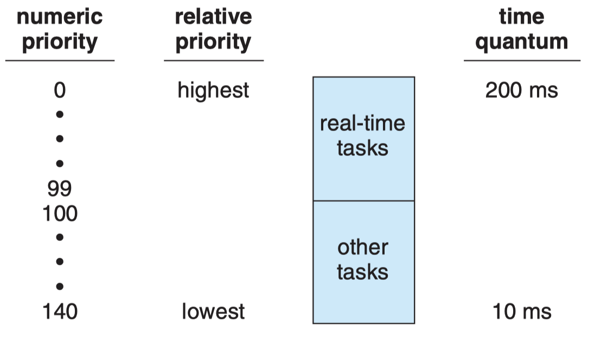
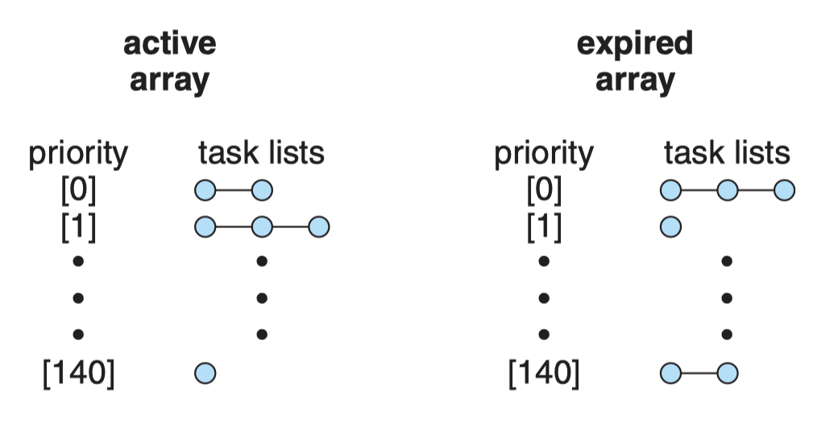
Linux Scheduling Through Version 2.5

Slide 34
Linux Scheduling in Version 2.6.23 +
Completely Fair Scheduler (CFS)
Scheduling classes
  Each has specific priority
  Scheduler picks highest priority task in highest scheduling class
  Rather than quantum based on fixed time allotments, based on proportion of CPU time
  2 scheduling classes included, others can be added
    default
    real-time
Quantum calculated based on nice value from -20 to +19
  Lower value is higher priority
  Calculates target latency – interval of time during which task should run at least once
  Target latency can increase if say number of active tasks increases
CFS scheduler maintains per task virtual run time in variable vruntime
  Associated with decay factor based on priority of task – lower priority is higher decay rate
  Normal default priority yields virtual run time = actual run time
To decide next task to run, scheduler picks task with lowest virtual run time

Slide 35

CFS Performance

Slide 36

Linux Scheduling (Cont.)
Real-time scheduling according to POSIX.1b
  Real-time tasks have static priorities
Real-time plus normal map into global priority scheme
Nice value of -20 maps to global priority 100
Nice value of +19 maps to priority 139

Slide 37
Windows Scheduling
Windows uses priority-based preemptive scheduling
Highest-priority thread runs next
Dispatcher is scheduler
Thread runs until (1) blocks, (2) uses time slice, (3) preempted by higher-priority thread
Real-time threads can preempt non-real-time
32-level priority scheme
Variable class is 1-15, real-time class is 16-31
Priority 0 is memory-management thread
Queue for each priority
If no run-able thread, runs idle thread

Slide 38
Windows Priority Classes
Win32 API identifies several priority classes to which a process can belong
  REALTIME_PRIORITY_CLASS, HIGH_PRIORITY_CLASS, ABOVE_NORMAL_PRIORITY_CLASS,NORMAL_PRIORITY_CLASS, BELOW_NORMAL_PRIORITY_CLASS, IDLE_PRIORITY_CLASS
  All are variable except REALTIME
A thread within a given priority class has a relative priority
  TIME_CRITICAL, HIGHEST, ABOVE_NORMAL, NORMAL, BELOW_NORMAL, LOWEST, IDLE
Priority class and relative priority combine to give numeric priority
Base priority is NORMAL within the class
If quantum expires, priority lowered, but never below base

Slide 39
Windows Priority Classes (Cont.)
If wait occurs, priority boosted depending on what was waited for
Foreground window given 3x priority boost
Windows 7 added user-mode scheduling (UMS)
  Applications create and manage threads independent of kernel
  For large number of threads, much more efficient
  UMS schedulers come from programming language libraries like C++ Concurrent Runtime (ConcRT) framework

Slide 40

Windows Priorities

Slide 41

Algorithm Evaluation
How to select CPU-scheduling algorithm for an OS?
Determine criteria, then evaluate algorithms
Deterministic modeling
  Type of analytic evaluation
  Takes a particular predetermined workload and defines the performance of each algorithm for that workload
Consider 5 processes arriving at time 0:

Slide 42



Deterministic Evaluation
For each algorithm, calculate minimum average waiting time
Simple and fast, but requires exact numbers for input, applies only to those inputs
  FCS is 28ms:
  Non-preemptive SFJ is 13ms:
  RR is 23ms:

